Slide 1
Building Your Own Docker Container Cloud on IBM Power Systems: A Client Use Case
Setharmi Seelam
Yong Feng
Pradipta Kumar Banerjee
Bruce Anthony

Slide 2
Please Note:
IBM’s statements regarding its plans, directions, and intent are subject to change or withdrawal without notice and at IBM’s sole discretion.
Information regarding potential future products is intended to outline our general product direction and it should not be relied on in making a purchasing decision.
The information mentioned regarding potential future products is not a commitment, promise, or legal obligation to deliver any material, code or functionality. Information about potential future products may not be incorporated into any contract.
The development, release, and timing of any future features or functionality described for our products remains at our sole discretion.
Performance is based on measurements and projections using standard IBM benchmarks in a controlled environment. The actual throughput or performance that any user will experience will vary depending upon many factors, including considerations such as the amount of multiprogramming in the user’s job stream, the I/O configuration, the storage configuration, and the workload processed. Therefore, no assurance can be given that an individual user will achieve results similar to those stated here.

Slide 3
Agenda
Client Use Case for a Container Cloud
Client Requirements
Design Choices
Architecture and Implementation
Lessons Learned and Opportunities Identified
IBM’s New Container Solution: IBM Spectrum Conductor for Containers
Driven by learnings from clients
Open Source Based with Enterprise Hardening and Scalability
Demo

Slide 4
Client Overview
Large Financial Services Organization
Currently running their .COM infrastructure of hundreds of Web Applications on Websphere on Power/AIX
Modernization of Applications a Strategic Priority:
Faster more Agile Development using modern tools and languages
SQL and No SQL DB’s
Containers
Java and Node.js Applications
Shift to a DevOps Methodology
Shift to a Microservices style Architecture to gain flexible and dynamic scalability to rapidly respond to changes in Website Patterns
Move to a Scale-Out Hardware Infrastructure
Chose Docker Containers on Linux on Power8 as the new Foundation
Partnered with IBM to design a Docker Cloud Environment

Slide 5
Client Container Cloud Requirements:
Hundreds of Web Applications
Support Thousands of Containers in a Production Environment
Utilize Open Source Components where possible
RHEL 7 LE (host)
Docker
Logging
Network Architecture
Storage Architecture
Security, Integration with LDAP/AD
HA
Backup
Dashboard/UI
Autoscaling

Slide 6
Cloud Native Docker Container Cloud
Client Use Case
User Applications (Internal and External)
Self Service Developer Portal to Get Containers and Data Services
Registry UI
Web
Apps
Web
Apps
Supporting a new Cloud Native DevOps Docker model with a Scale Out Infrastructure
Modernizing Hundreds of Websphere Apps on Power providing services both to internal employees and external clients
Embracing Open Source Technologies like Docker, Mongo, Redis etc.
Cooperatively Integrating Open Source Components to deliver a complete Container Cloud Service
Production by 4Q16
Web
Apps
Web
Apps
Web
Apps
Web
Apps
Data Services
Web
Apps
Open Source Tooling and SW
Mongo
Redis
etc
SQL
DB’s
Registry
…
Kubernetes Container Management Service
Operations Dashboard
Docker Containers
RedHat 7.1 LE Linux O/S & KVM
Power Compute Node Cloud
Approx 100’s of Systems
SDN

Slide 7
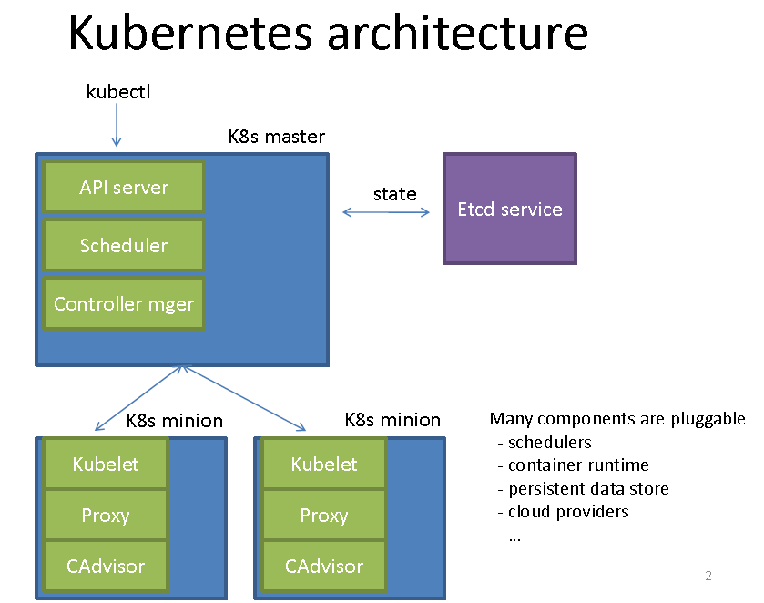
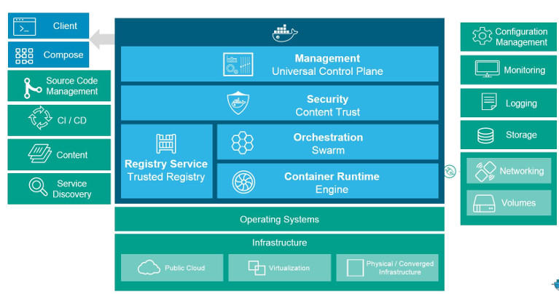
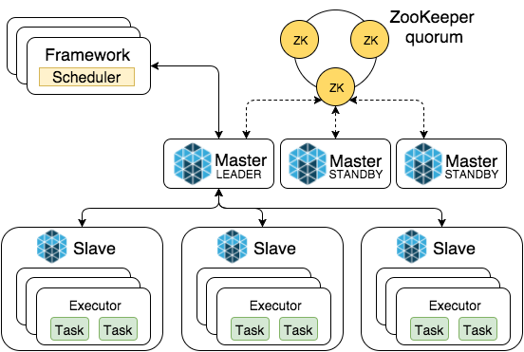
Open Source Options for Container Cloud Orchestration on Power
Docker Swarm/Datacenter
Mesos
Kubernetes
Docker Inc
Mesosphere
Google
Strengths
Built-in to Docker 1.12 Engine
Easy to use for Small Clouds
Weaknesses
Full Docker DC not on Power Yet
Strengths
Good for Batch and Analytics
Lots of Apps in Catalog
Weaknesses
Less usage in Web Applications
Requires Marathon Framework for Web Apps
Strengths
Lots of Industry usage and experience for Web Apps
Synergy with Other parts of Client Business for X86 Container Mgmt
Weaknesses
Significant Integration of many components for Production Cloud

Slide 8
Kubernetes Cluster Components

Slide 9
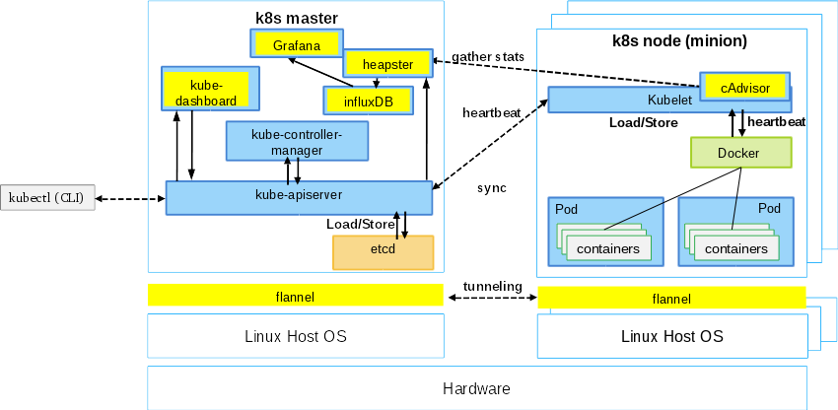
Kubernetes Component Interaction

Slide 10
Client Environment
F5 Virtual IP (VIP) and port is configured for
K8s master
K8s slaves
Etcd distributed key-value store
Any direct communication between servers in Environment-1 and Environment-2 needs to be explicitly allowed by Firewall rules
K8s master and slaves are configured to use Flannel overlay network for PODs
Heapster/InfluxDB/Grafana is used for K8s resource monitoring
Ingress (with Nginx) is used for exposing services to clients
Clients
F5 Loadbalancer
K8s Master
Flannel
Firewall
Docker Private Registry
K8s Slaves
K8s Slaves
Environment-1
Environment-2

Slide 11
Overview of Kubernetes Dashboard Functionality
Kubernetes Dashboard - easy to use web UI providing the following functionalities:
Creation/Deletion of Applications
Creation/Deletion Replication Controllers
Specify advanced POD Options – privileged containers, CPU and Memory constraints, Labels, Namespace etc
Check Application State
Allows uploading of YAML or JSON file for Deployment

Slide 12
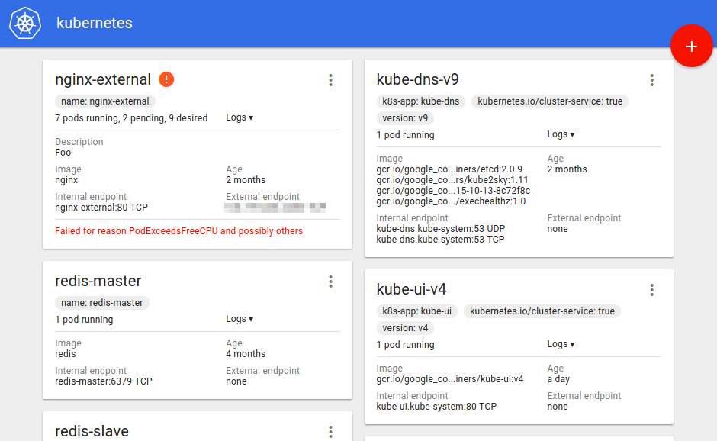
Example of Kubernetes Dashboard User Interface

Slide 13
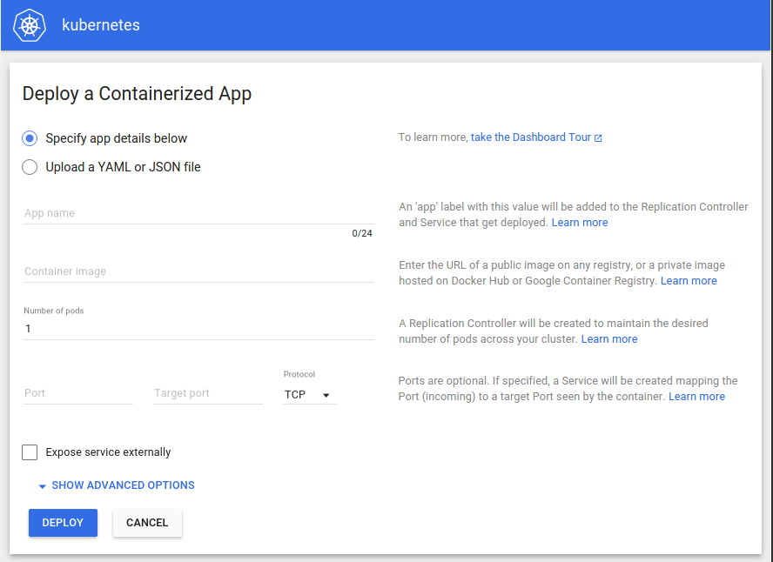
Example of Kubernetes Dashboard User Interface - 2

Slide 14
Integration with Client’s Enterprise LDAP Server
Kubernetes uses namespaces to partition the cluster among multiple users
Three steps to Access:
Authentication
Authorization
Admission Control
Kubernetes supports Openstack Keystone Component for Authentication
Keystone Provides LDAP/AD Integration
Existing
LDAP
Keystone
Authorization defines what a Authenticated user can and can’t do:
AlwaysDeny: Used only for testing - AlwaysAllow: Used only for testing
ABAC: Attribute-based access control - Webhook: Calls out to an external authorization service via a REST call
ABAC based Authorization
Auth policies need to be created for every user and can be changed only by API server restart
Every user get's their own namespace
Read/write access to their own namespace
Read access to default (global) namespace

Slide 15
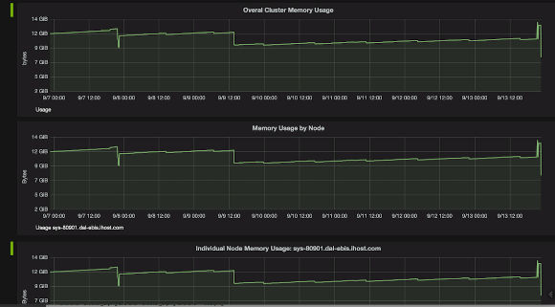
Overview of Monitoring Functionality
Kubernetes monitoring is via CAdvisor
Kubernetes Cluster/CAdvisor
Source
Sink
Heapster
InfluxDB
Grafana
System View
Pod View
Notes:
https://github.com/kubernetes/heapster/blob/master/docs/model.md
https://github.com/kubernetes/heapster/blob/master/docs/storage-schema.md
https://github.com/kubernetes/heapster/blob/master/docs/source-configuration.md
--source=kubernetes:<KUBERNETES_MASTER>[?<KUBERNETES_OPTIONS>]
--source=kubernetes.summary_api:<KUBERNETES_MASTER>[?<KUBERNETES_OPTIONS>]

Slide 16
Logging
All kubernetes logs are in journald
Docker logging uses JSON
Splunk integration is being explored for integration into Client Logging tools
K8s metadata is part of docker container labels.
Log rotation is external and is handled separately

Slide 17
Container Cloud Lessons Learned
Identified Gaps in current state of Kubernetes
Lots of disparate parts to integrate, challenging to install/deploy
User interface is basic and not integrated across all components of the solution
Security is complicated and not complete, missing a UI
Resource Management incomplete
Integration with existing networking environment is challenging
Must fit into clients production networking environment and policies
Some client policies need to evolve – e.g. Live Internet Connection for building and maintaining Open Source
Now the hard part comes: Operations 24x7, High Availability, live rolling Upgrades, secure validation of Containers etc.
Notes:
16

Slide 18
Client Use Case Container Cloud Summary
Kubernetes Container Cloud Environment based on Open Source Technologies Operational
System Test and Validation in process at Client
First Container Based Applications being piloted on the Cloud
Production Target on track for October Go Live
Notes:
17

Slide 19
IBM Spectrum Conductor for Containers Capabilities

Slide 20
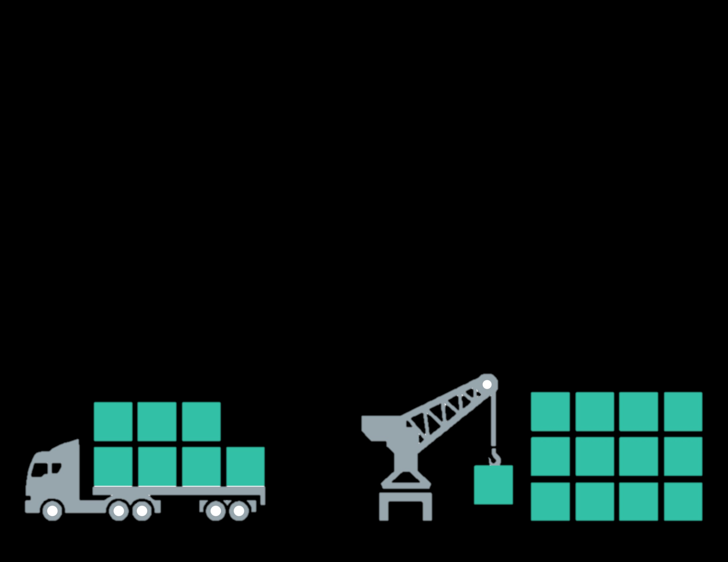
Embrace Open Source
Community Value | IBM Value-add | Customer Value
Docker Hub Registry holds a repository of 75000+ Docker images Lots of application integrated with Mesos Kubernetes enable micro-service architecture | Client unique registry available on premises Security readiness guidance via the Vulnerability Advisor Build-in applications of popular open source projects and IBM enterprise products in App Store | Access to the images and application you require to deploy containers that meet your business needs and strategy
Open-source, standardized, lightweight, self sufficient container technology | Balance workload between on-prem and off-prem Deployment choice with openPOWER and x86_64 | Flexibility to choose on-prem and off-prem or mix for your business
Build, ship, and run standardized containers | Integrated monitoring & logging Elasticity to grow storage & container needs Integrated CI/CD flow Life-cycle management of containers and data volumes | Docker ease of use combined with enterprise-level integrity and confidence
19

Slide 21

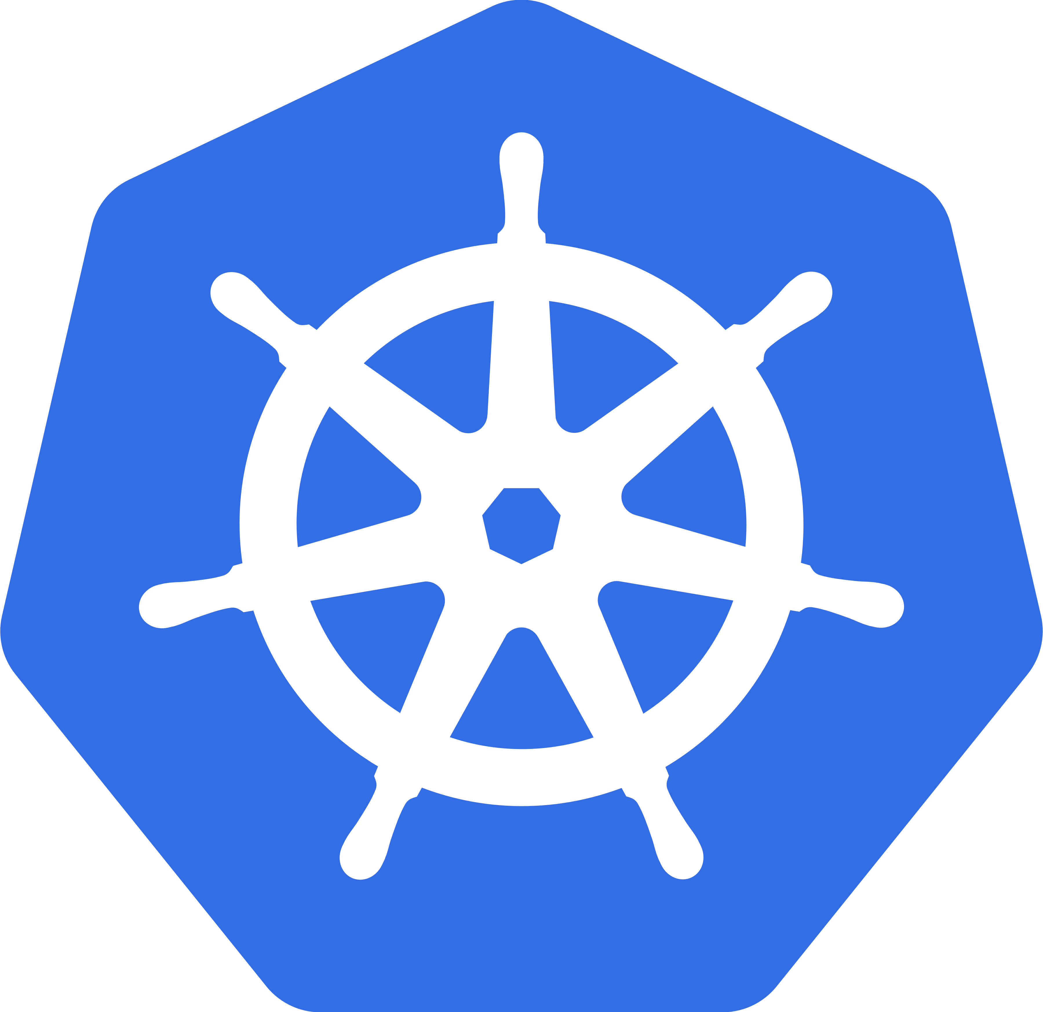

Simplify Container Management with Integrated Controls
App Catalog
Integrated
Open
Security
High Available
Customer-managed
Unified UI
Container Orchestration
Resource scheduling
Auto-scaling
Conductor
Resource Management
Security
On-Premise
Development
Delivery
Infrastructure
Power & X86
20

Slide 22





Full Lifecycle Management for Container
Container orchestration
Resource management
Application life-cycle management/schedule/deployment
Scaling, Rolling upgrade
Service Registry/Discovery
Container infrastructure
Load Balance
Multi-host Networking
Distribute storage management
Image/Software repository management
Configure management
Logs/Meters/Alert
User/Account management (Multiple tenancy & RBAC)
Ops management
Installation/upgrade
Health check
Cloud Native
Spark
IBM Spectrum Conductor for Containers
Unified Web-based Interface
Monitoring and Reporting
Private Registry
Pattern based
cluster template
Pattern based
cluster template
Computing
Framework
Resource Management
x86
Hypervisor
21

Slide 23
Spectrum Conductor Overview Architecture
Watson / Cognitive
Spectrum Conductor with Spark
Container Cloud for POWER
App Store
Authentication
Authorization
GUI
Workflow
Installer
(Deploy, Reconfigure, HA, Scale, Rolling update)
Kubernetes
Session Scheduler
HPC
Persistent Volume
Service Discovery
Mesos Master
Service Load Balance
Distributed Key-value Store
Trouble-shooting
Monitor
Mesos Agent
K8s executor
container
container
Network Topology
Image registry
pod
pod
pod
container
container
22

Slide 24
Spectrum Conductor for Containers Architecture
Master Node
Heapter
km ctrl
manager
km
apiserver
km
scheduler
Mesos
master
MySQL
master mgr
network mgr
appstore
cfc-router
Image-mgr
haproxy
Kube-DNS
etcd
GUI
cfc-auth
Keystone
LDAP Server
Boot Node
Ansible based installer and ops manager
VIP
VIP
VIP
Mesos Agent
Mesos Agent
Mesos Agent
km
agent
km
proxy
km
agent
km
proxy
km
agent
km
proxy
Docker
Docker
Docker
Pod
Pod
Pod
Pod
Pod
Pod
Pod
Pod
Pod
Flanneld
Flanneld
Flanneld
Agent Node
Agent Node
Agent Node
23

Slide 25
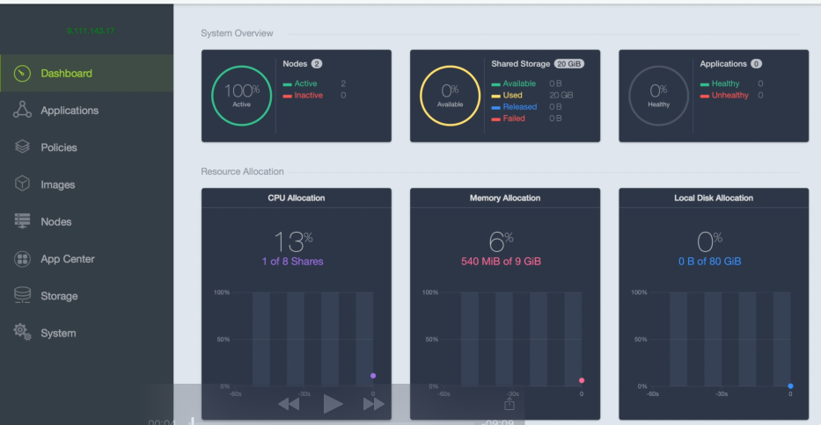
Spectrum Conductor for Container GUI
Improve Developer Productivity
1
Create a Container Cloud for developers supporting DevOps practices and cloud-native apps. Pre-built app catalog for fast deployment of OSS tools. Reduce developer friction, creating faster time to results
Increase Resource Utilization
2
Fine grain, dynamic allocation of resources maximizes efficiency of Spark instances sharing a common resource pool.
Reduce Administration Costs
3
Proven architecture at extreme scale, with enterprise class workload management, monitoring, reporting, and security capabilities.
24

Slide 26
Response to the Lesson Learned
Gaps in current state of Kubernetes
Single installer and operation manager to manage disparate parts together
Unified GUI as management console for various services
Single API end-point
Single user service end-point and load balancer
Central authentication and authorization manager
Resource manager to support various workload manager and fine-grain resource sharing
Enterprise Requirement
HA topology
System services live rolling upgrade and live reconfiguration
Heterogonous environment (Power, X86, GPU and so on)
Trouble-shooting, audit, alarm and event
Multiple site
25

Slide 27
Conductor for Containers Community Edition
Community Edition v0.1 (Tech Preview) is releasing soon!
Free to use as you wish.
We are looking for feedback for our roadmap.
Register on our community page: http://ibm.biz/ConductorForContainers

Slide 28
Release Timeline
Information regarding potential future products is intended to outline our general product direction and it should not be relied on in making a purchasing decision. The information mentioned regarding potential future products is not a commitment, promise, or legal obligation to deliver any material, code or functionality. Information about potential future products may not be incorporated into any contract. The development, release, and timing of any future features or functionality described for our products remains at our sole discretion.
Community Edition 0.1
Initial version
Kubernetes&Mesos API/CLI
GUI
Installer and HA
Authentication LDAP
App store
Private image registry
Sample Apps in App Store
Nginx, SockShop
Build-in Network
Flannel
Build-in Persistent Storage
NFS, Glusterfs
HW Support
Power, x86
Community Edition 0.2
Spark
Spark Session Scheduler
Open Source
Rebase on fr8r
Kubernetes
Build-in ingress service
HW Support
Z
Community Edition 0.3
CI/CD flow
Jenkins
Jenkins git/cvs
Jenkins private docker registry
Batch
Kubernetes batch
Build-in App in App Store
Marathon, Tomcat, React & Django, blockchain, tensorflow, R-studio, OpenCV,
3Q16
4Q16
1Q17
27

Slide 29
Demo

Slide 30
Thank You

Slide 31
Backup

Slide 32
Software Define the Infrastructure with Templates
Overview
Powerful lifecycle management for scale-out cluster environments
Key Capabilities
Simplified management with cluster template designer
Scales from single clusters to complex multi-team environments
Robust, scalable alerting and reporting
Automated infrastructure management – one-click cluster deployment
Enhanced Cluster management: cluster maintenance, health check and cluster upgrade (Bulk and Rolling)
Benefits
Faster time to cluster readiness
Unified interface for management and monitoring
Increased administrator productivity
Single infrastructure supporting multiple business needs
IBM Spectrum LSF
IBM Spectrum Conductor
IBM Spectrum Cluster Foundation
Unified Web-based Interface
Monitoring and Reporting
Cluster template designer
Pattern based
cluster template
Pattern based
cluster template
Workload based
cluster template
Infrastructure Management
x86
Hypervisor
31

Slide 33
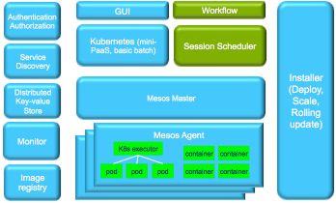

Spectrum Conductor with Infrastructure Management
DevOps
PaaS
BD & A
Simplify IT operations
1
Discover bare metals and quickly deploy the environment on-demand (bare metal, virtualization or hybrid)
Load Balance
Authentication
Image Registry
(OS, VM, container)
Increase Resource Utilization
2
Fine grain, dynamic allocation of resources maximizes efficiency of servers (Bare metals and VMs) sharing a common resource pool.
SW Repository
Logging/Metric
Alert & Policy
Reduce Administration Costs
3
Proven architecture at extreme scale, with enterprise class infrastructure management, monitoring, reporting, and security capabilities.
Infrastructure Resource Aggregation
Cluster Deployment
xCAT
Bare-Metal
Generic
Public Cloud
adapter
Infrastructure discovery
32

Slide 34
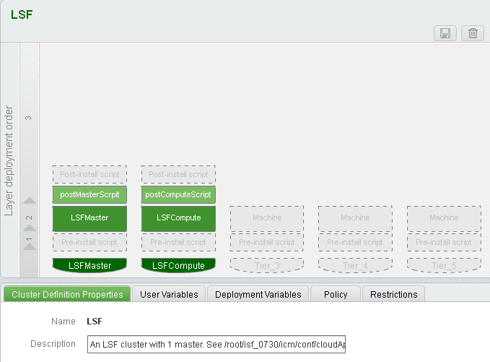



Deliver an Agile Containerization Infrastructure in Enterprise
Benefits
Auto deploy customized OpenStack to offer the virtualization pools
Auto deploy two container management environments on both bare metals and virtual machines.
Easy to adjust the size of container management environments to balance the workload，and full
Building up Multi-tenant management based on LDAP
Virtualizations Pools
Conductor Cluster#2
Conduct Cluster#1
POD
POD
POD
POD
POD
POD
Monitor & Health
Automation
VM
VM
VM
VM
Deploy
scale
Docker Engine
OpenStack (KVM)
Design
upgrade
Spectrum Scale
Spectrum Scale
Elastic
scale in/out
Operating System
Operating System
Bare Metal
Bare Metal
IBM Spectrum Cluster Foundation
Cluster Template
Orchestration
xCAT
OpenStack
Provisioning
Storage
Network
Server
Server
Server

Slide 35
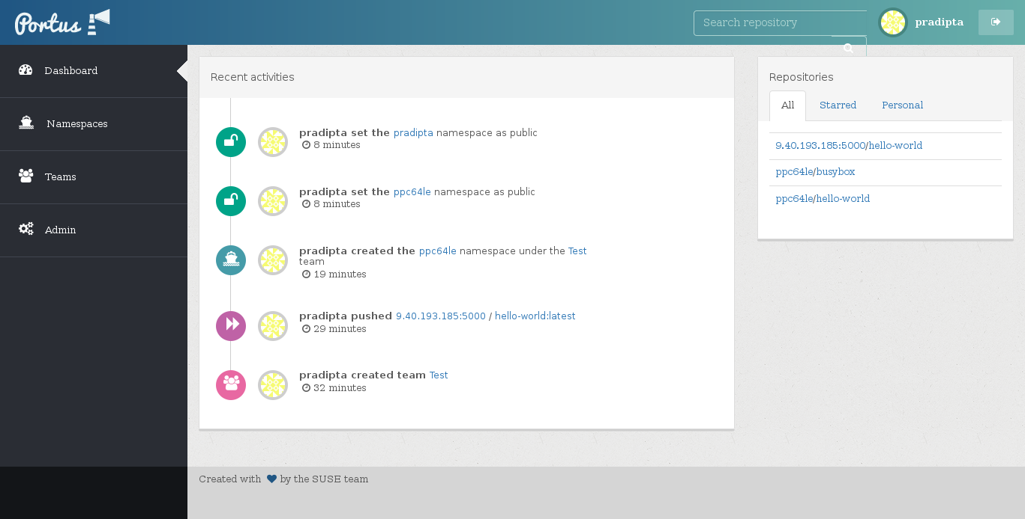

Portus Registry Dashboard
Synchronization with your private registry in order to fetch which images and tags are available.
LDAP user authentication.
Fine-grained control of permissions.
Monitoring of all the activities performed onto your private registry and Portus itself.
Search for repositories and tags inside of your private registry.
Star your favorite repositories.
Disable users temporarily.
Users that fail at logging in too many times will have their account locked.
Users can recover their password if they forgot it.
Proposed to Client, but they Selected ISV Software
Notes:
34

Slide 36
Notices and Disclaimers
Copyright © 2016 by International Business Machines Corporation (IBM). No part of this document may be reproduced or transmitted in any form without written permission from IBM.
U.S. Government Users Restricted Rights - Use, duplication or disclosure restricted by GSA ADP Schedule Contract with IBM.
Information in these presentations (including information relating to products that have not yet been announced by IBM) has been reviewed for accuracy as of the date of initial publication and could include unintentional technical or typographical errors. IBM shall have no responsibility to update this information. THIS DOCUMENT IS DISTRIBUTED "AS IS" WITHOUT ANY WARRANTY, EITHER EXPRESS OR IMPLIED. IN NO EVENT SHALL IBM BE LIABLE FOR ANY DAMAGE ARISING FROM THE USE OF THIS INFORMATION, INCLUDING BUT NOT LIMITED TO, LOSS OF DATA, BUSINESS INTERRUPTION, LOSS OF PROFIT OR LOSS OF OPPORTUNITY. IBM products and services are warranted according to the terms and conditions of the agreements under which they are provided.
IBM products are manufactured from new parts or new and used parts. In some cases, a product may not be new and may have been previously installed. Regardless, our warranty terms apply.”
Any statements regarding IBM's future direction, intent or product plans are subject to change or withdrawal without notice.
Performance data contained herein was generally obtained in a controlled, isolated environments. Customer examples are presented as illustrations of how those customers have used IBM products and the results they may have achieved. Actual performance, cost, savings or other results in other operating environments may vary.
References in this document to IBM products, programs, or services does not imply that IBM intends to make such products, programs or services available in all countries in which IBM operates or does business.
Workshops, sessions and associated materials may have been prepared by independent session speakers, and do not necessarily reflect the views of IBM. All materials and discussions are provided for informational purposes only, and are neither intended to, nor shall constitute legal or other guidance or advice to any individual participant or their specific situation.
It is the customer’s responsibility to insure its own compliance with legal requirements and to obtain advice of competent legal counsel as to the identification and interpretation of any relevant laws and regulatory requirements that may affect the customer’s business and any actions the customer may need to take to comply with such laws. IBM does not provide legal advice or represent or warrant that its services or products will ensure that the customer is in compliance with any law

Slide 37
Notices and Disclaimers Con’t.
Information concerning non-IBM products was obtained from the suppliers of those products, their published announcements or other publicly available sources. IBM has not tested those products in connection with this publication and cannot confirm the accuracy of performance, compatibility or any other claims related to non-IBM products. Questions on the capabilities of non-IBM products should be addressed to the suppliers of those products. IBM does not warrant the quality of any third-party products, or the ability of any such third-party products to interoperate with IBM’s products. IBM EXPRESSLY DISCLAIMS ALL WARRANTIES, EXPRESSED OR IMPLIED, INCLUDING BUT NOT LIMITED TO, THE IMPLIED WARRANTIES OF MERCHANTABILITY AND FITNESS FOR A PARTICULAR PURPOSE.
The provision of the information contained herein is not intended to, and does not, grant any right or license under any IBM patents, copyrights, trademarks or other intellectual property right.
IBM, the IBM logo, ibm.com, Aspera®, Bluemix, Blueworks Live, CICS, Clearcase, Cognos®, DOORS®, Emptoris®, Enterprise Document Management System™, FASP®, FileNet®, Global Business Services ®, Global Technology Services ®, IBM ExperienceOne™, IBM SmartCloud®, IBM Social Business®, Information on Demand, ILOG, Maximo®, MQIntegrator®, MQSeries®, Netcool®, OMEGAMON, OpenPower, PureAnalytics™, PureApplication®, pureCluster™, PureCoverage®, PureData®, PureExperience®, PureFlex®, pureQuery®, pureScale®, PureSystems®, QRadar®, Rational®, Rhapsody®, Smarter Commerce®, SoDA, SPSS, Sterling Commerce®, StoredIQ, Tealeaf®, Tivoli®, Trusteer®, Unica®, urban{code}®, Watson, WebSphere®, Worklight®, X-Force® and System z® Z/OS, are trademarks of International Business Machines Corporation, registered in many jurisdictions worldwide. Other product and service names might be trademarks of IBM or other companies. A current list of IBM trademarks is available on the Web at "Copyright and trademark information" at: www.ibm.com/legal/copytrade.shtml.

